Slide 1
Aim: How can we transfer our knowledge of ancient civilizations to write a comparative essay?

Slide 2
No Candy Today-Only Civilizations

Slide 3
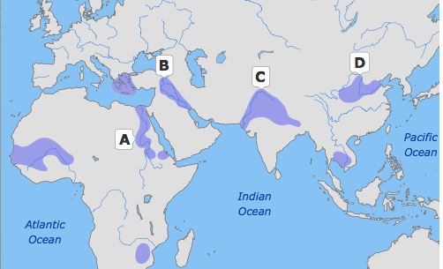

Slide 6
Comparative Essay
Essay Question:
Compare two Ancient River Valley Civilizations in terms of geography, achievements, social structure, politics, or religion.

Slide 7
Best Two Civilizations to Compare?
Work with a partner

Slide 8
Elements of Civilization

Slide 9
Partner Up-Create Venn Diagram

Slide 10
Best 2 Similarities, 2 Differences

Slide 11
RULE OF THREE!

Slide 13
Thesis

