Slide 1
Aim: Is tyranny sometimes necessary? How do we determine "greatness" in history?

Slide 2
George Washington

Slide 4
American Greatness

Slide 5
Directions
Warring States Period-as a class
2 document sets-4 groups total
Graphic Organizer as a class

Slide 6
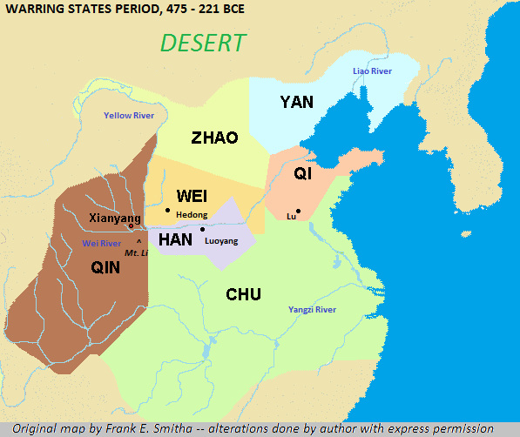

Slide 7
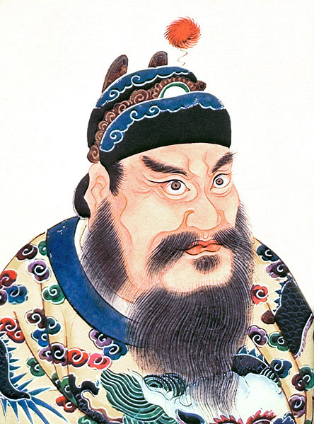
Shi Huangdi

Slide 8
Admin.

Slide 9
Law

Slide 10
Personality

Slide 11
WAS HE GREAT?

Slide 12
Admin.

Slide 13
Law

Slide 14
Personality

Slide 15
Administration/general policy

Slide 16
Laws

Slide 17
Personal Qualities

Slide 18
Was Shi Huangdi great? Why? Was he necessary for China?

