Slide 1
A Map is a representation of a geographical area in a way that enables people to find places and/or to better understand the features of a particular destination.

Slide 2
Parts of a map
Title- tells you what the map is and usually found on the top or bottom of the map.
Scale- the relationship between distance on a map and actual distance on the earth.
Key- a part of a map used to define symbols on the map

Slide 3
Parts of a map
Grid- the set of lines that show coordinates on a map
Orientation- the relationship between the directions on the map and the corresponding compass directions in reality.

Slide 4
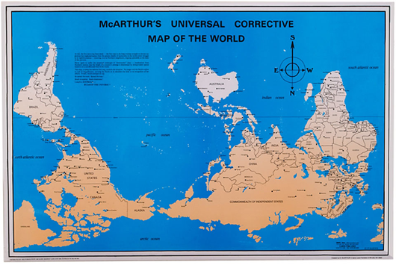

Slide 6
Projections
Representing the earth's surface in two dimensions causes distortion in the shape, area, distance, or direction of the data.

Slide 8
The West Wing-
Map Projection Clip
https://www.youtube.com/watch?v=vVX-PrBRtTY

Slide 9

Physical Map

Slide 10
Political Map

Slide 11
Topographical Map-contour lines and extreme detail

Slide 12
Thematic Map-emphasizes a particular theme or special topic

Slide 13
Climate Map

Slide 14
Economic or Resource map

