Slide 1
Proselytizing

Slide 2
Aim: To what extent can a religion expand without coercion and force?

Slide 4
Clip of "Proselytizing"
https://www.youtube.com/watch?v=GtXSXCcgNEM
Why is this an ineffective method of converting someone to another religion?
What do you think would be a more effective method? Why?
Why is voluntary conversion more effective?

Slide 5
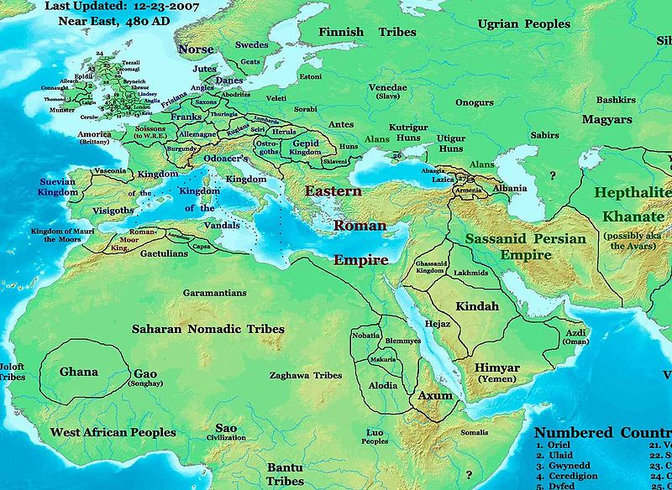

Slide 6
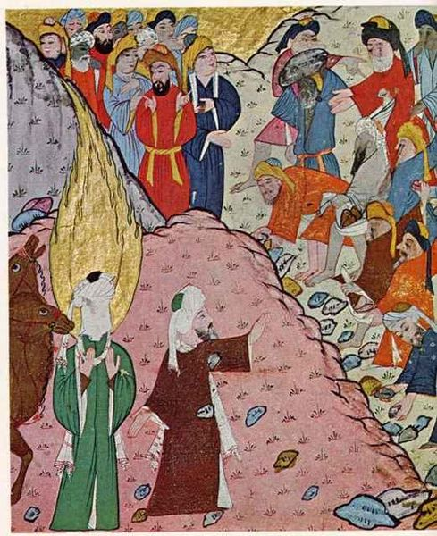
Abu Bakr saves Muhammed
Muhammed gains control of Mecca, Medina and parts of Arabia

Slide 7
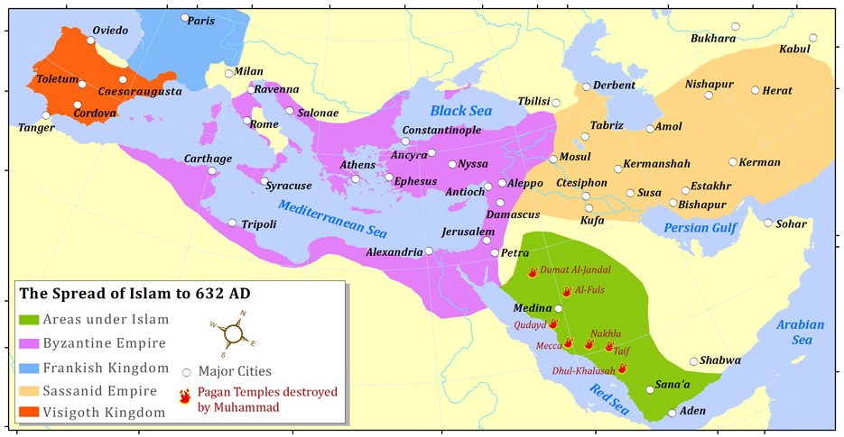
Expansion up to 632 CE (green)

Slide 8
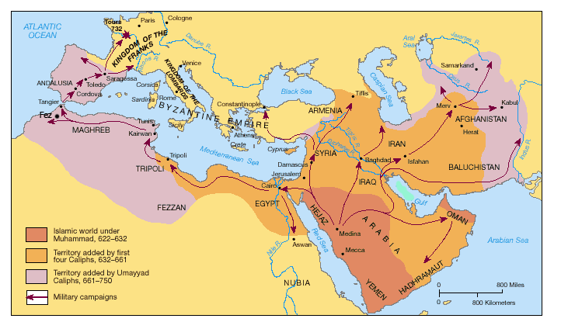
Expansion of Islam Map
Muhammad leads the umma (community of Muslims), dies 632 CE

Slide 9
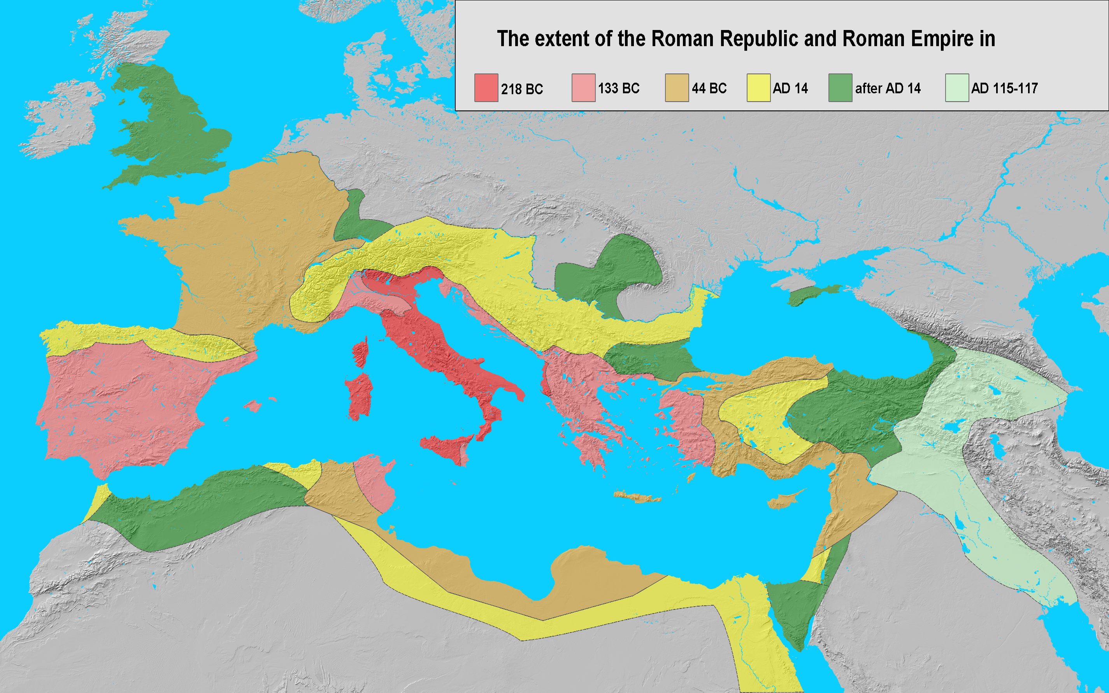
Rome’s Expansion takes 218 BCE-117 CE

Slide 10
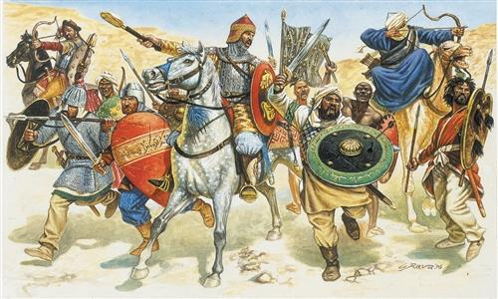
Caliphs (men who replaced Muhammad as leader of the umma) defeated Eastern Romans and Sasanian Persians
Why was it so easy?
Belief in Islam?
Divine Intervention?
Or something else?

Slide 12
Conquered an empire->Now What?

Slide 13
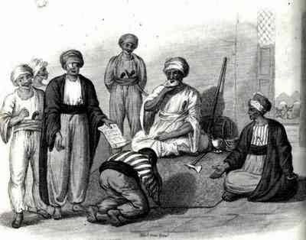
Pact of Umar
Dhimmi-non-Muslims living under Muslim rule
THESE ARE THE CHRISTIANS AGREEING TO RULES SET BY MUSLIMS
Jeezdya-

Slide 14
SHEG 3 documents of the Arab Conquest Document A

Slide 15
Document B

Slide 16
Document C

Slide 17
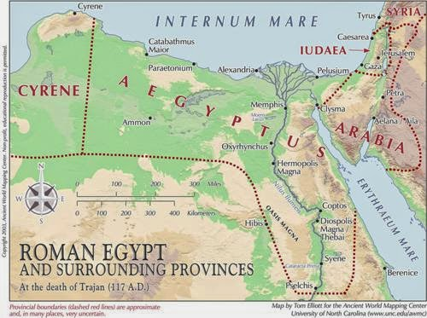
Final Statistic: Egypt conquered by 670 CE
50% Muslim by 900 CE: 90% Muslim by 1200 CE
Takes almost 600 years for most of Egypt to convert:
What does this show about the Islamic conquest and subsequent conversion?

