Slide 1
Aim: How can we compare the elements of classical civilizations?

Slide 2
Heads Up! We need 1 student volunteer

Slide 3
Satrap

Slide 4
Bureaucracy

Slide 5
Legalism

Slide 6
Stupas

Slide 7
Ashoka

Slide 8
Monsoon Winds

Slide 9
Constantinople/Istanbul

Slide 10
Hellenistic Culture

Slide 11
Comparing Classical Empires

Slide 12
Democracy

Slide 13
Alexander the Great

Slide 14
Greek Gods and Values

Slide 15
Parthenon

Slide 16
Roman Empire

Slide 17
Christianity

Slide 18
The 12 Tables

Slide 19
Roman Architecture

Slide 20
Mandate of Heaven

Slide 21
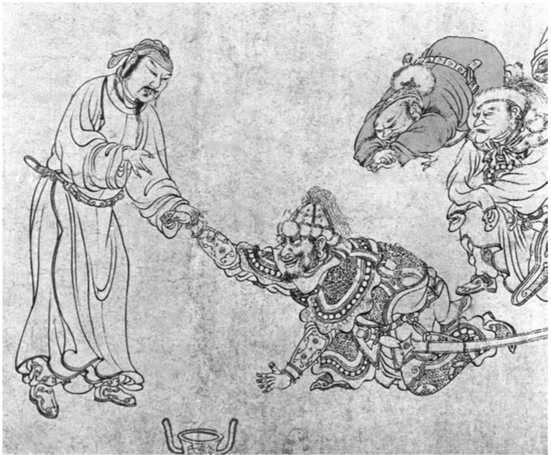
Tribute System

Slide 22
Confucianism, Daoism, Buddhism

Slide 23
China continued
        Which achievement does America use today for many jobs that the government provides?

Slide 24
Fall of Rome

Slide 25
Fall of the Han
Dynastic Cycle

Slide 26
Causes of Rome’s Fall

Slide 27
Collapse of the Gupta

