Slide 1
AIM: How can religion define a civilization?
Ancient Hebrews

Slide 2
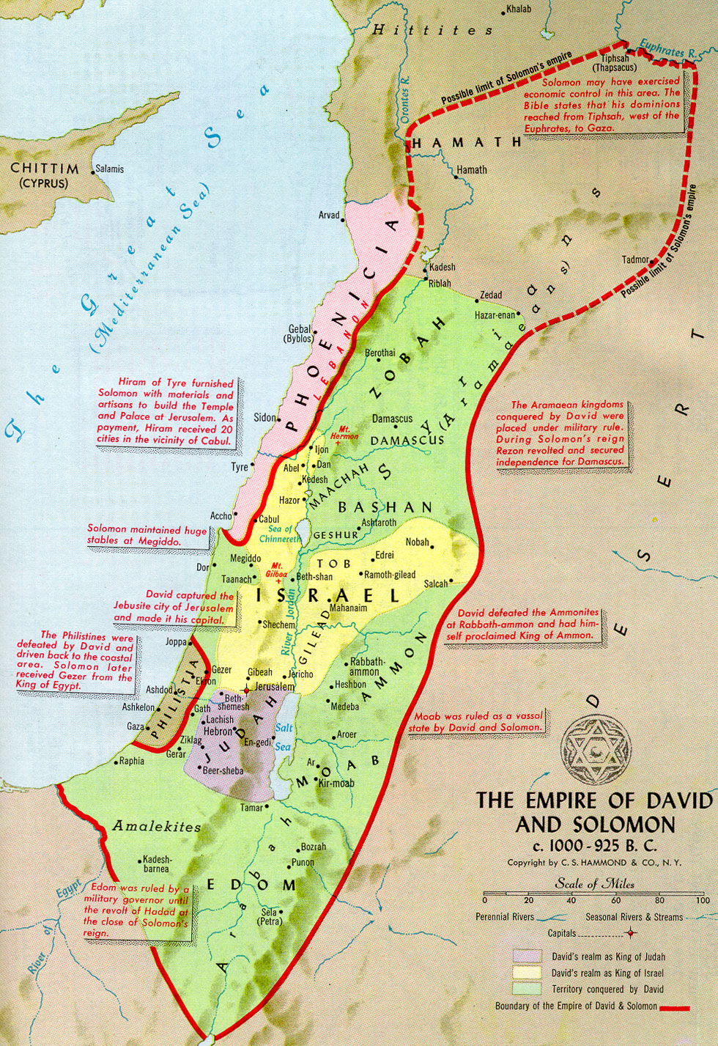
HEBREWS
ISRAELITES
JEWS
Hebrews - Speakers of the ancient Hebrew language
Israelites – Descended from Hebrews who settled in Palestine and formed the Kingdom of Israel
Jews – Descendants of kingdom of Judah. Short form of Judeans

Slide 3
Origins of Judaism
Early Hebrews were pastoral nomads in the lands between Egypt and Mesopotamia.
Early Hebrews believed in multiple gods
Abraham leads the Hebrews to Palestine
Makes covenant (pact) with Yahweh
Hebrews believe themselves to the ‘chosen people’
What is the difference between Hebrews and Jews?

Slide 4
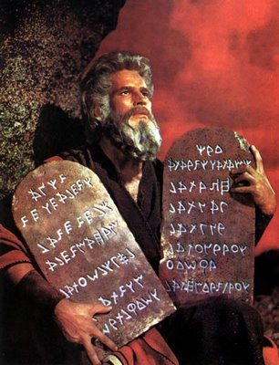
Exit to Egypt… Exit from Egypt
Drought drives the Israelites to Egypt
This time coincides with unrest in Egypt
Once order is restored, the Hebrews are enslaved
Moses leads Hebrews out of Egypt
- Embraces monotheism
Recognizes one supreme god, Yahweh
Eternal & Omnipotent
Transcendent (above nature)
- First clearly developed monotheistic religion

Slide 5
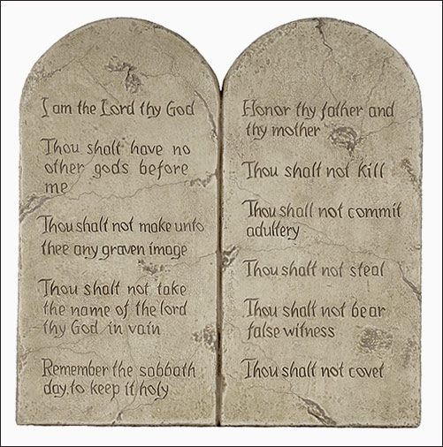
God gives Moses the 10 Commandments
Ethical monotheism – the belief in one God who demands righteous behavior from his human creations

Slide 6
Create a State
Israelites, along with other smaller groups overtake Canaanites settled in the region
Form the 12 tribes
Hebrew kingdom is formed
3 successive kings: Saul, David, and Solomon
Established bureaucracy, major trade, building programs, chariot army, slaves
Built Solomon’s Temple (aka First Temple)
Not a ziggurat

Slide 7
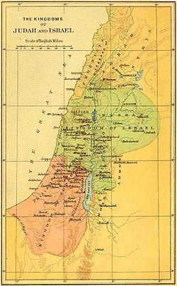
Two Hebrew Kingdoms
Prophets claimed corruption and neglect by those in the aristocracy
Taxes, slaves, social stratification
After King Solomon’s
reign (970-930) the Israelites
split into two kingdoms
Israel: Northern kingdom
Judea: Southern kingdom
Capital city of Jerusalem

Slide 8
Torah & Jewish Law
Torah – Hebrew for doctrine/ teaching
Is the same as the first 5 books of the Old Testament of the Christian Bible (Genesis, Exodus, Leviticus, Numbers, Deuteronomy)
Deuteronomy: “…You shall remember that you were a slave in Egypt; therefore I command you to do this.”
Jewish Law was concerned with high morals and ethical standards
Emphasized people’s rights over property rights
Placed importance on charity
Yahweh could reward his people or punish them

Slide 9
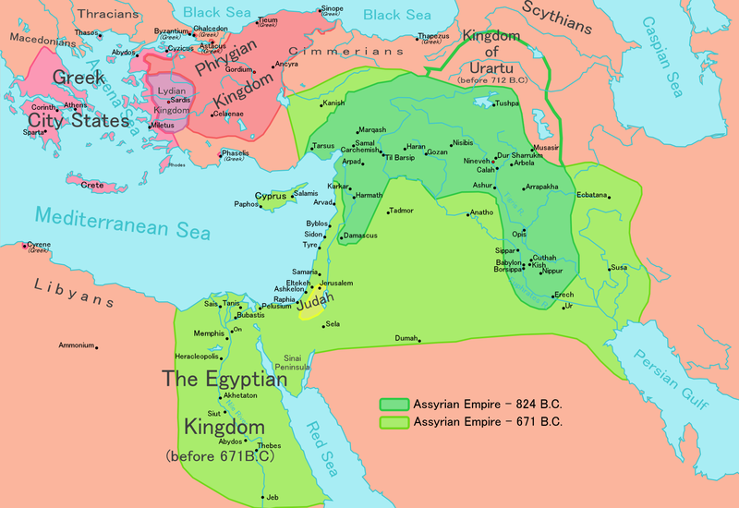
Kingdoms Come … and Go
722 B.C.E – Assyrians conquer northern kingdom and expelled the Israelites
Assimilated into other communities and lost their identity
586 B.C.E – New Babylonian empire conquers Assyrians
and Kingdom of Judah
- Destroyed Jerusalem
- Destroyed Solomon’s Temple
- Exiled but keep their identity (Jews)

Slide 10
By the Waters of Babylon
Babylonian Jews – exiled Jews who enjoyed a life of wealth and prosperity in Babylon
Diaspora- dispersion / scattering
Wanted to maintain their unique identity
Jews maintained their culture, formed a strong identity
Created synagogues (bringing together)
Communal meeting place for religious, social, educational

