Slide 1
Aim: How can myth inform us about history?

Slide 2
“The face that launched a 1,000 ships…”
The Legend of Troy-Iliad and Odyssey

Slide 3
Homer-8th century BCE author of Iliad and Odyssey

Slide 4
Catalogue of ships-Compare w/map
Boeotians, Minyans, Phoceans, Locrians, Athenians, Salamineans, Argives, Mycenaeans, Lacedamonians (Spartans), Arcadians, Epeans, Cephallenians, Aetolians, Cretans, Rhodians, Symians, Acheans, Pelasgians, Magnetes, and others…

Slide 5
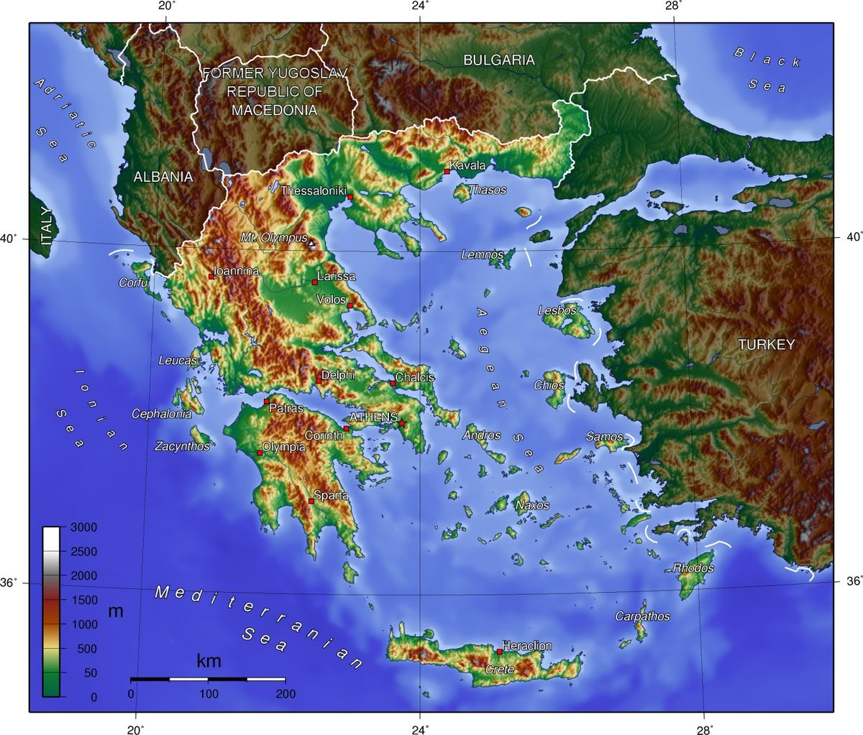

Slide 6
How does the map explain this long list of different groups?

Slide 7
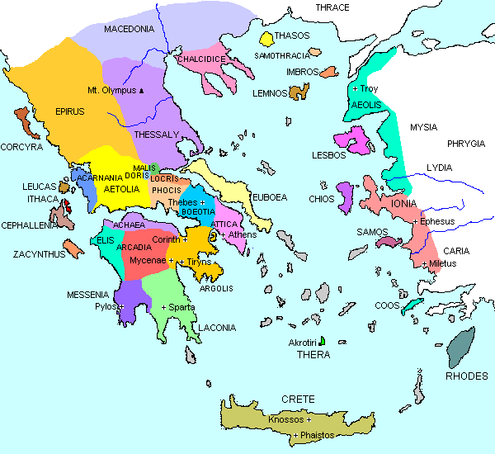

Slide 9
Greek Origins
Minoans- inhabited island of Crete

Slide 10
Minoan Palace at Knossos

