Slide 1
Aim: How did early humans adapt to their environments?

Slide 2
Do-Now:
Who wins in a fight? A lion or a human?
What if the human is allowed time to prepare?
WHY?

Slide 3
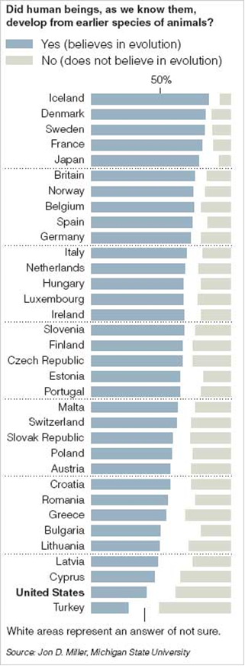
U.S. “Belief” in Evolution, 2005
The United States had the second-highest percentage of adults who said the statement (mankind evolved from apes) was false and the second-lowest percentage who said the statement was true (53%)
Only adults in Turkey expressed more doubts on evolution. In Iceland, 85 percent agreed with the statement.
WHY?

Slide 4
Think-Pair-Share Activity
Rank the Hominid Worksheet-Rank the various levels of humans 1 (the least advanced) to 5 (most advanced)
Be prepared to explain why

Slide 6
What is Prehistory?
Think back to last week

Slide 7
Prehistory
Period in history between the first man to the invention of writing

Slide 8
Archeology & Anthropology
Artifacts: objects made by humans
Archeology: study of the past people and cultures through their material remains (tools, weapons, pottery, clothing, and jewelry)
Lean about beliefs, values, and activities of humans in the past
Anthropology: study of humans societies and cultures and their development
Culture: the way of life of a society-beliefs, values, and practices

Slide 9
Evolution
the process by which different kinds of living organisms are thought to have developed and diversified from earlier forms during the history of the earth.
Charles Darwin: 19th century geologist and biologist
Natural selection: the process whereby organisms better adapted to their environment tend to survive and produce more offspring

Slide 10
First Humans
Donald Johnson: anthropologist
Discovered the first complete human skeleton- dated to 3 million years ago
1974, Ethiopia
Lucy- upright walker, approximately 4 feet tall

Slide 13
Two main versions of the Out of Africa theory:
1) Homo erectus to Homo sapiens in Africa then migrated throughout globe
2) Multi-regional: Homo erectus migrates first then evolves into Homo sapiens separately in different regions while cross-breeding

