Slide 1
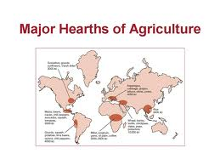
Change Over Time Thesis: Identifies both Changes and Continuities
During the Neolithic era (10.000B.C.E -4000B.C.E) early man developed settlements based on the new stable food supply, formed patriarchal societies denying women opportunities men were given while retaining the spiritual and religious relationship with their natural surroundings.
Sample
thesis

Slide 2
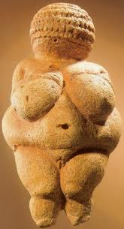
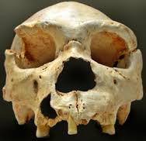
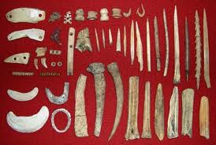
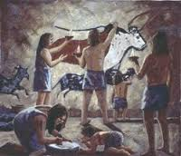
Characteristics of Paleolithic Period
The people were hunters and gatherers
They lived in small groups of about 20-30 people
Sexual division of labor(women gathered/men hunted)
Nomadic people who followed game and ripening fruit
Developed simple tools from stone, bone or wood
Invented clothing
Cave paintings and religious rituals

Slide 3
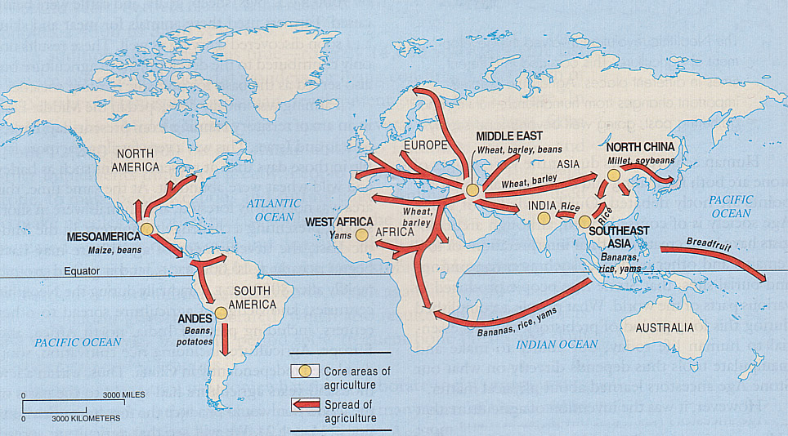
The Neolithic Revolution
Agriculture Slowly Spreads: What do you notice about the core areas?
Notes:
What is life like if all plants and animals had to remain in their indigenous locations? How would the world have developed differently? Similar?
Choose a topic/product/idea- what does their “Spread” Map look like now(2010)?

Slide 4
Thematic changes and continuities
changes | continuities
Food became more stable Domestication of plants and animals(pastoralism) Food surplus led to labor specialization Division of labor ( specialization) Permanent settlements began to be built Patriarchy to protect inherited property began Population began to increase Governments and religions became more complex Metals began to develop ( metallurgy) Slash and burn agriculture Wheeled vehicles and plows developed First villages and town (Catal Huyuk and Jericho) Trade will increase amongst settled societies Deforestation and erosion from settlement and mining | Fire still important for cooking, light, warmth (etc) Hunting and gathering ( it works) Religion maintained understanding of the world Men still tended to be dominant due to sexual dimorphism Humans still migrated in bands Still relied heavily on environment Still had trade ( although increased) Conflict over resources continued Still no written system Still vulnerable to environmental factors Still many violent interactions between humans Many areas geographically unable to domesticate (Steppes,Mountains, Deserts) initially-geographic determinism

Slide 5
The Neolithic Revolution
Independent Development vs.
Cultural Diffusion
Areas of Independent Development:
SW Asia (wheat, pea, olive, sheep, goat)
China & SE Asia (rice, millet, pig)
Americas (corn, beans, potato, llama)
Areas of Agriculture Through Diffusion:
Europe
West & Sub-Saharan Africa (?)
Indus River Valley (rice cultivation)

Slide 6
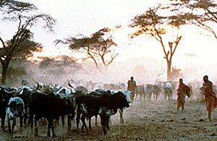
The Neolithic Revolution
Interactions Between Nomadic Peoples and Sedentary Agricultural Peoples
Some nomadic peoples
engaged in pastoralism
(herding).
Some practiced slash & burn agriculture.
The violent and peaceful interaction between nomads and agriculturalists endures throughout history. (Trade & raids)

Slide 7
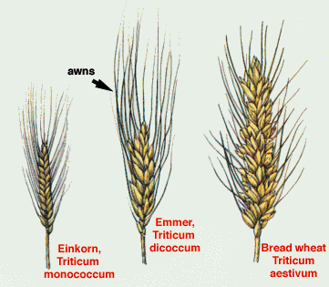
The Neolithic Revolution
Sedentary Agriculturalists Dominate
High starch diets slowly allow
Sedentary populations to grow.
First plow invented c.6000BCE;
crop yields grow exponentially by 4000BCE.
Pop. grows from 5-8 million to 60-70 million.
Eventually agricultural populations begin to spread out, displacing( casting out) or assimilating(blending in) nomadic groups; farming groups grow large enough for advanced social organization.

Slide 8
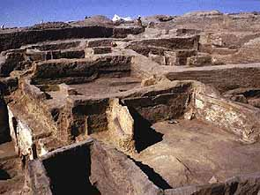
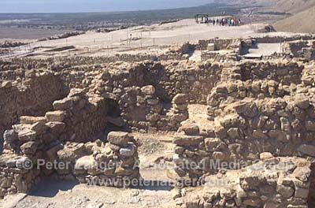
The Neolithic Revolution
First Towns Develop
Catal Huyuk
Modern Turkey
First settled:
c. 7000BCE
Jericho
Modern Israel
First settled:
c. 7000BCE

Slide 9
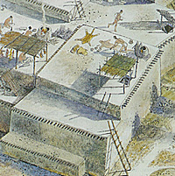
The Neolithic Revolution
Towns Present Evidence of:
Religious structures
(burial rites, art)
Political & Religious leaders were the same
Still relied on limited hunting & gathering for food

Slide 10
The Neolithic Revolution
Metal Working: From Copper to Bronze
The working of metals became very important to early human settlements for tools & weapons.
Early settlements gradually shifted from copper to the stronger alloy bronze by 3,000BCE—ushers in the Bronze Age!
Metal working spread throughout human communities slowly as agriculture had.

Slide 11
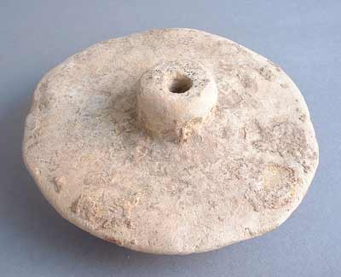
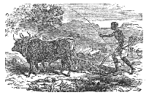
The Neolithic Revolution
Further Technological Advancements
 | Wheeled Vehicles Saves labor, allows transport of large loads and enhances trade
 | Potters Wheel (c.6000BCE) Allows the construction of more durable clay vessels and artwork
 | Irrigation & Driven Plows Allows further increase of food production, encourages pop. growth

Slide 12
The Neolithic Revolution
Early Human Impact on the Environment
Deforestation in places where copper, bronze, and salt were produced.
Erosion and flooding where agriculture disturbed soil and natural vegetation.
Selective extinction of large land animals and weed plants due to hunting & agriculture.

Slide 13
The Neolithic Revolution
First Towns Develop
Towns require social differentiation: metal workers, pottery workers, farmers, soldiers, religious and political leaders.
(POSSIBLE B/C FOOD SURPLUSES!)
Served as trade centers for the area; specialized in the production of certain unique crafts
Beginnings of social stratification (class)

Slide 14
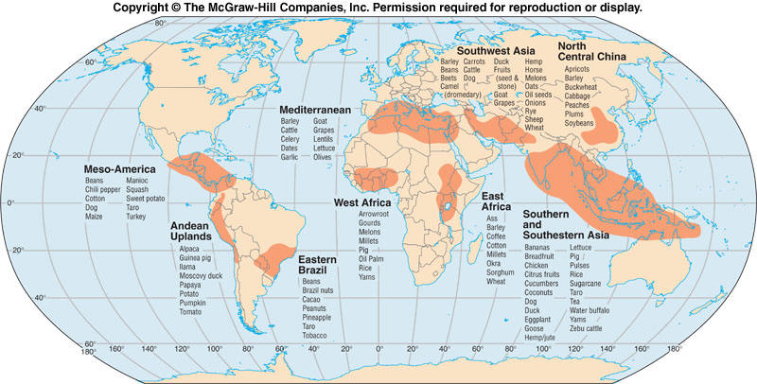
Some things to consider
Independent innovation vs cultural diffusion
Some areas proved more favorable to agriculture while others were more favorable to pastoralism (herding)
Differences in geography led to differences in plants and animals
The Middle East (SW Asia) domesticated first because thawing of the ice age happened there first
Sedentary societies had different priorities than pastoral.
A similarity can also be a difference. How?

