Slide 1
Aim: What is the difference between order and equality?

Slide 2
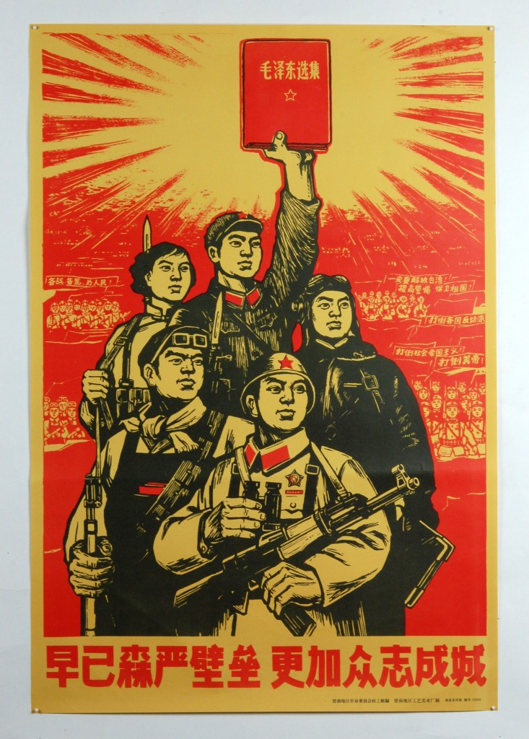
Communist China

Slide 3
Article Quote: Why China Is Turning Back to Confucius-WSJ Sept. 2015
President Xi Jinping:
“To solve China’s problems, we can only search in the land of China for the ways and means that suit it…
We need to fully make use of the great wisdom accumulated by the Chinese nation over the last 5,000 years.”

Slide 4
QUESTIONS
1) Questions: How can you justify China reverting back to Confucianism?
2) Do you believe this will be a positive change for China?

Slide 5
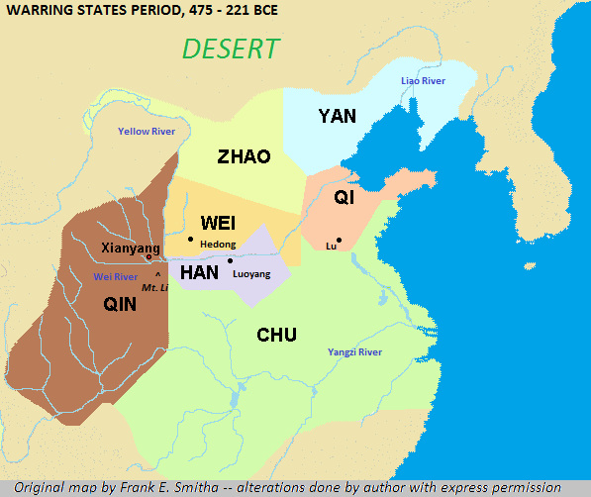
Warring States

Slide 6
Directions
6 groups of 4-5
Packet on different aspects of Confucianism
Answer questions and fill out your portion of the chart: HOW DO THE TEACHINGS IN THE FIRST BOX SUPPORT OR CONTRADICT THE SECOND BOX

Slide 7
The Five Relationships
Father-Son
Ruler-Subject
Husband-Wife
Elder Brother-Younger Brother
Friend-Friend

Slide 8
Filial Piety

Slide 17
Government War

Slide 18
Humaneness Women, Servants

Slide 19
Teachers Filial Piety

Slide 20
How can a philosophy provide the comfort and stability of a religion?
Belief system vs. religion
Order vs. equality

